Slide 1
JAVA Programming
Course Instructor: Dr. Suvojit Dhara
School of Computer Science
UPES Dehradun

Slide 2
TOPICs to be discussed
Nested Interfaces
Variables in Interfaces
Marker Interfaces
Serializable
Cloneable
Remote
Some other most used Interfaces
Iterator
Comparable

Slide 3

Let’s START …!!!

Slide 4
Nested Interfaces
An interface can be declared as a member of a class or another interface. Such an interface is called a member interface or a nested interface.
class class_name { interface first {
interface interface_name { interface second {
. . . . . . . . . . .
} }
} }
Properties:
A nested interface can be declared as public, protected, or private [private, and protected only if the interface is nested in a class]. This differs from a top-level interface, which must either be declared as public or use the default access level.
When a nested interface is used outside of its enclosing scope, it must be qualified by the name of the class or interface of which it is a member. Thus, outside of the class or interface in which a nested interface is declared, its name must be fully qualified.

Slide 5
Nested Interfaces (Example)
class A {
interface B {
void interface_B();
}
}
class C implements A.B {
public void interface_B() {
System.out.println("Interface nested
inside class");
}
}
class Nested_Interface1 {
public static void main(String[] args) {
C obj = new C();
obj.interface_B();
}
}
interface A {
interface B {
void interface_B();
}
}
class C implements A {
public void interface_B() {
System.out.println("Interface nested
inside interface");
}
}
class Nested_Interface2 {
public static void main(String[] args) {
C obj = new C();
obj.interface_B();
}
}
Output:
Interface nested inside class
Output:
Interface nested inside interface

Slide 6
Nested Interfaces (Example)
interface A {
void interface_A();
interface B {
void interface_B();
}
}
class C implements A, A.B {
public void interface_A() { System.out.println("Interface method"); }
public void interface_B() { System.out.println("Nested Interface method"); }
}
class Nested_Interface3 {
public static void main(String[] args) {
C obj = new C();
obj.interface_A();
obj.interface_B();
}
}
Output:
Interface method
Nested Interface method

Slide 7
Variables in Interfaces
You can use interfaces to import shared constants into multiple classes by simply declaring an interface that contains variables that are initialized to the desired values.
When you include that interface in a class (that is, when you implement the interface), all of those variable names will be in scope as constants.
import java.util.Random;
interface SharedConstants {
int NO = 0;
int YES = 1;
int MAYBE = 2;
int LATER = 3;
int SOON = 4;
int NEVER = 5;
}
Note: This program makes use of one of Java’s standard classes: Random, which provides pseudorandom numbers.

Slide 8
Variables in Interfaces (Example)
class Question implements SharedConstants {
Random rand = new Random();
int ask() {
int prob = (int)
(100*rand.nextDouble());
if (prob < 30)
return NO;
else if (prob < 60)
return YES;
else if (prob < 75)
return LATER;
else if (prob < 98)
return SOON;
else
return NEVER;
}
}
class AskMe implements SharedConstants {
static void answer(int result) {
switch(result) {
case NO: System.out.println("No");break;
case YES: System.out.println("Yes");break;
case MAYBE: System.out.println("Maybe");break;
case LATER: System.out.println("Later");break;
case SOON: System.out.println("Soon");break;
case NEVER: System.out.println("Never");break;
}
}
public static void main(String[] args) {
Question q = new Question();
answer(q.ask()); answer(q.ask());
answer(q.ask()); answer(q.ask());
}
}
Output: Yes
Soon
Later
No

Slide 9
Marker Interfaces
A marker interface (also known as Tag interface) in Java is an interface that has no methods or constants inside it.
It is used to indicate to the JVM or other developers that the classes implementing this interface belong to a specific category.
Marker interfaces are used to provide metadata to objects, indicating that they have certain properties or should be treated in a particular way.
Some of the well-known marker interfaces in Java are:
Serializable
Cloneable
Remote

Slide 10
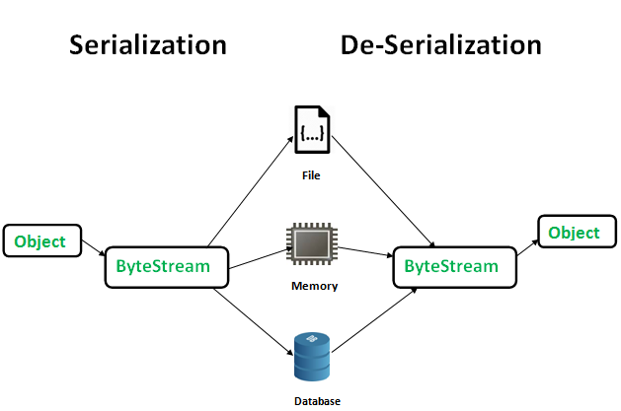
Serializable Interface
The Serializable is a marker interface present in the java.io package.
Being a marker interface, it does not contain any constants or methods. Hence, classes implementing it do not have to implement any methods. Classes implement the Serializable interface if they want their instances to be serialized or de-serialized.
Serialization: It is a mechanism of converting the state of an object into a byte stream. Serialization is done using ObjectOutputStream.
De-Serialization: It is the reverse process where the byte stream is used to recreate the actual object in memory. Deserialization is done using ObjectInputStream.

Slide 11
Serializable Interface (Example)
import java.io.*;
class Student implements Serializable {
int SAP_ID;
String name;
public Student(int id, String s) { SAP_ID = id; name = s; }
}
class MyClass {
public static void main(String[] args)
throws IOException, ClassNotFoundException {
Student s1 = new Student(101, "Amit");
//Serialization
FileOutputStream fos = new FileOutputStream("xyz.txt");
ObjectOutputStream oos = new ObjectOutputStream(fos);
oos.writeObject(s1);
//De-serialization
FileInputStream fis = new FileInputStream("xyz.txt");
ObjectInputStream ois = new ObjectInputStream(fis);
Student s2 = (Student)ois.readObject();
System.out.println(s2.SAP_ID+" "+s2.name);
oos.close(); ois.close();
}
}
Output:
101 Amit

Slide 12
Cloneable Interface
Cloneable is a marker interface present in java.lang package.
There is a method clone() in Object class. A class that implements the Cloneable interface indicates that it is legal for clone() method to make a field-for-field copy of instances of that class.
Invoking Object’s clone() method on an instance of the class that does not implement the Cloneable interface results in an exception CloneNotSupportedException being thrown. By convention, classes that implement this interface should override Object.clone() method.
protected Object clone() throws CloneNotSupportedException
This interface allows the implementing class to have its objects to be cloned instead of using a new operator.

Slide 13
Cloneable Interface (Example)
import java.lang.Cloneable;
class Student implements Cloneable {
int SAP_ID;
String name;
public Student(int id, String s) { SAP_ID = id; name = s; }
protected Object clone() throws CloneNotSupportedException {
System.out.println("Cloning in progress...");
return super.clone();
}
}
class MyClass {
public static void main(String[] args)
throws CloneNotSupportedException {
Student s1 = new Student(101, "Amit");
//cloning 's1' and holding new cloned object reference in s2
//down-casting as clone() return type is Object
Student s2 = (Student)s1.clone();
System.out.println(s2.SAP_ID);
System.out.println(s2.name);
}
}
Output:
Cloning in progress...
101
Amit

Slide 14
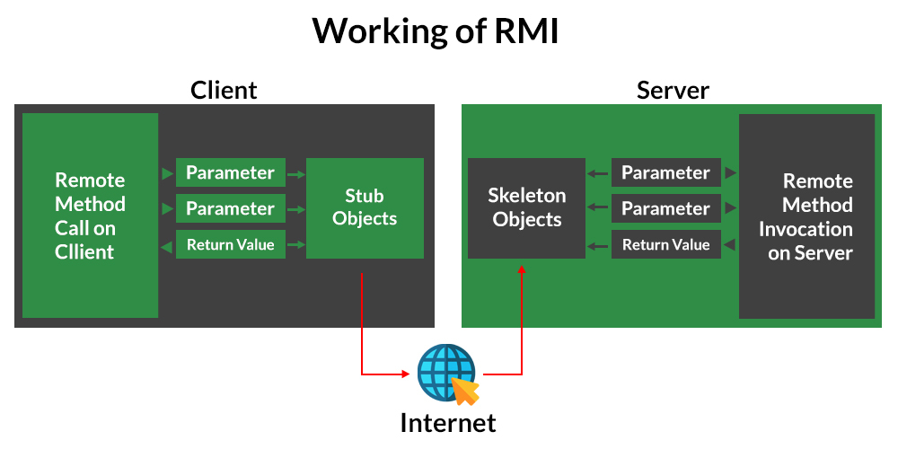
Remote Interface
Remote Interface is a marker interface in Java, defined in java.rmi package.
It is used for Remote Method Invocation (RMI) purposes.
Remote Method Invocation: It is a mechanism that allows an object residing in one system JVM to access/invoke an object running on another system JVM.
Stub Object: The stub object on the client machine builds an information block and sends this information to the server.
Skeleton Object: The skeleton object passes the request from the stub object to the remote object.

Slide 15
Some other commonly used Interfaces
Some other most used interfaces in Java are:
Iterator
Comparable
These are not marker interfaces and contain a body (members and methods).

Slide 16
Iterator Interface
The Iterator interface in Java is part of the java.util package.
It is used to iterate over a collection of objects.
It provides methods to traverse a collection and remove elements from the collection.
public interface Iterator {
public abstract boolean hasNext(); //Checks if the collection has more elements
Object next(); //Returns the next object in the collection
void remove(); //optional throws exception
}

Slide 17
Iterator Interface (Example)
import java.util.Iterator;
class MyCollection implements Iterable<Integer> {
private Integer[] items; private int size;
public MyCollection(Integer[] items) {
this.items = items; this.size = items.length;
}
public Iterator<Integer> iterator() { return new MyIterator(); }
// Inner class that implements the Iterator interface
private class MyIterator implements Iterator<Integer> {
private int index = 0;
public boolean hasNext() { return index < size; }
public Integer next() { return items[index++]; }
}
}
class MyClass {
public static void main(String[] args) {
Integer[] numbers = {12, 20, 43, 34, 5};
MyCollection collection = new MyCollection(numbers);
for (Integer number : collection) {
System.out.println(number);
}
}
}
Output:
12
20
43
34
5

Slide 18
Comparable Interface
The Comparable interface is present in the java.lang package.
In Java, it is used to define the natural ordering of objects.
It contains a single method, compareTo, which is used to compare the current object with another object of the same type. It returns:
positive integer, if the current object is greater than the specified object.
negative integer, if the current object is less than the specified object.
zero, if the current object is equal to the specified object.
public interface Comparable {
public int compareTo(Object obj);
}

Slide 19
Comparable Interface (Example)
import java.util.*;
class Student implements Comparable<Student>{
int SAP_ID; String name; int age;
Student(int r, String s, int a){ SAP_ID = r; name = s; age = a; }
public int compareTo(Student st){
if(age == st.age) return 0;
else if(age > st.age) return 1;
else return -1;
}
}
class MyClass {
public static void main(String[] args) {
ArrayList<Student> arr = new ArrayList<Student>();
arr.add(new Student(1089,"Vijay",23));
arr.add(new Student(1063,"Ajay",27));
arr.add(new Student(1072,"Jai",21));
Collections.sort(arr);
for(Student st : arr) {
System.out.println(st.SAP_ID+" "+st.name+" "+st.age);
}
}
}
Output:
1072 Jai 21
1089 Vijay 23
1063 Ajay 27

Slide 20
Summary
Today, we learned about
Nested Interfaces
Variables in Interfaces (Shared Constants between classes)
Marker Interfaces (Serializable, Cloneable, Remote)
Some other Interfaces (Iterator, Comparable)

Slide 21


